Slide 1
Lesson 7
Architectural Analysis:
From Cosmic Mind To Manifest Creation
Notes:
ID Course Overview

Slide 2
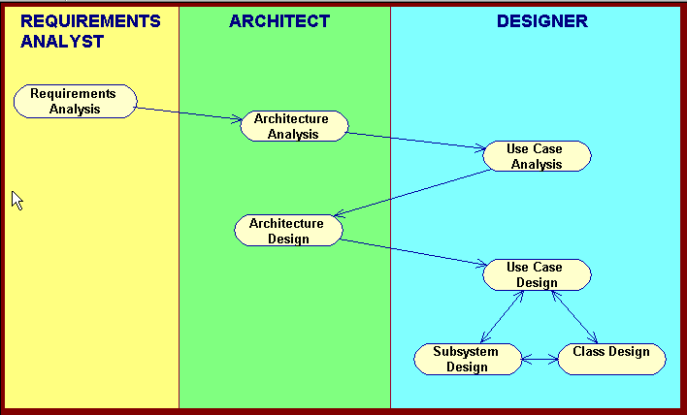
Basic RUP OOAD Activities

Slide 3
Architectural Analysis Topics
Hi-Level System Architecture
  Layers
  Analysis Mechanisms
  Key Abstractions
Modeling Conventions
Review

Slide 4
The Notion of a “Package”
A package allows design elements to be grouped at design-time
Conceptual container to which you can add other model elements, including packages
Usage
  Model organization and design element categorization
  Can be used as a unit of configuration management
Package Name
Notes:
ID Course Overview

Slide 5
Packages: Dependency Relationship
Packages can depend on another package or design element
Dependency Implications
    Changes to the Service Provider package may require a corresponding change in the Service User package
    Reuse of the Service User requires the additional baggage of the Service Provider
Service User
Service Provider
Dependency relationship
Notes:
ID Course Overview

Slide 6
Design Patterns
A design pattern is a customizable solution to a common design problem:
  Describes a common design problem
  Describes the solution to the problem
  Discusses the rationale, results and trade-offs of applying the pattern
Design patterns provide the capability to
  reuse successful designs
  capture master-class design expertise
Architectural patterns are design patterns applied to software architecture. Example: the Layering Pattern
Notes:
ID Course Overview
e.g., Façade pattern and mediator pattern in foop course

Slide 7
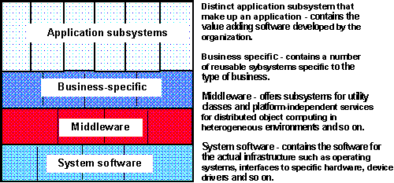
Typical Layered Architecture
Specific functionality
General functionality
NOTE: During Architectural Analysis, the focus is on the upper layers – application and business layers. The middleware and system software layers will be detailed in Architectural Design.

Slide 8
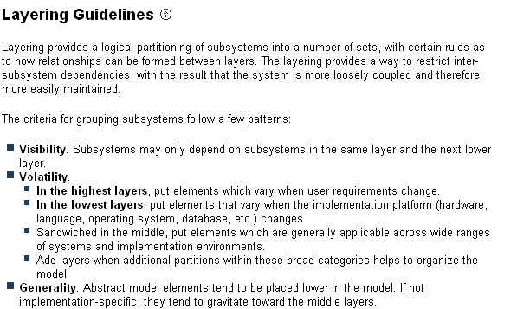
The Notion of Architectural Layers
Notes:
ID Course Overview
Layers are used to encapsulate conceptual boundaries between different kinds of services and provide useful abstractions which makes the design easier to understand.
When layering, you should concentrate on grouping things that are similar together, as well as encapsulating change.
The number and composition of layers is dependent upon the complexity of both the problem domain and the solution space. There is generally only a single application-specific layer. Domains in which previous systems have been built, or in which large systems are composed in turn of inter-operating smaller systems, there is a strong need to share information between design teams. As a result, the Business-specific layer is likely to partially exist and may be structured into several layers for clarity. Solution spaces which are well-supported by middleware products and in which complex system software plays a greater role will have well-developed lower layers, with perhaps several layers of middleware and system software.
Remember, in Architectural Analysis, we are concentrating on the upper-level layers (the application- and business-specific layers). The lower level layers (infrastructure and vendor-specific layers) will be defined in Architectural Design.

Slide 9
Notation for Modeling Architectural Layers
Use stereotyped packages to show Architectural layers
Use the “standard” <<layer>> stereotype
<<layer>>
Business Service

Slide 10
Model Organization : High-Level Example
<<layer>>
Application
<<layer>>
Business
Services

Slide 11
Architectural Analysis Topics
Hi-Level System Architecture
  Layers
  Analysis Mechanisms
  Key Abstractions
Modeling Conventions
Review

Slide 12


The Notion of Analysis Mechanisms:
Required Functionality
Implementation Environment
“realized by client classes using”
“constrained by”
Mechanisms
COTS Products
Databases
IPC Technology
etc.
Supplementary
Specification
“responsible for”
Use-Case Model
Architect

Slide 13
The Notion of Analysis Mechanisms
A project’s analysis mechanisms are standards for how common design problems are to be solved on this project
  Promotes uniformity of solutions and increases possibility of reuse, ease of maintenance and minimizes entropy of multiple solution strategies
  An analysis mechanism is often an architectural pattern for the project.
Whenever possible, represent in diagrams as a placeholder
  Short-hand representation for complex behavior
Example: Plan to use a legacy database (since it is a known constraint) and represent the database as a placeholder in diagrams. Don’t need to design the database or the infrastructure for connecting since company already knows how this should be done – mechanism is known.

Slide 14
Identifying Analysis Mechanisms
Two approaches:
Top Down -- use well-known approaches in the context of your new application (e.g. persistence)
Bottom Up -- identify some pattern in emerging application that is relevant for the current application and possibly others (e.g. a rules engine)

Slide 15
Sample Analysis Mechanisms
Distribution of components on multiple tiers
Transaction management
Concurrency
Persistency
Security
Error and Exception detection / handling / reporting
Rules engine
Wrapping of legacy systems
Messaging (MQ Series)
Notes:
ID Course Overview
The “mechanisms” are, in a sense, a short-hand for ‘complex stuff we don’t want to have to explain right now.
Analysis mechanisms provide specific behaviors to a domain-related class or component, or correspond to the implementation of cooperation between classes and/or components.
A persistent object is one that logically exists beyond the scope of the program that created it.
Examples of communication mechanisms would include inter-process communication (IPC) and inter-node communication (a.k.a. remote process communication or RPC). So with RPC, there is both a communication and a distribution aspect.
Mechanisms are perhaps easier to discuss when one talks about them as ‘patterns’ that are applied to the problem. So the inter-process communication pattern (i.e. “the application is partitioned into a number of communicating processes”) interacts with the distribution pattern (i.e. “the application is distributed across a number of nodes”) to produce the RPC pattern (i.e. “the application is partitioned into a number of processes, which are distributed across a number of nodes”) which provides us a way to implement remote IPC.
Some examples of analysis mechanisms are listed on this slide. This list is not meant to be exhaustive.

Slide 16
Example: E-bazaar Analysis Mechanisms
Persistence
Distribution (not in first phase)
Security (not in first phase)
Legacy Interface
Business Rules
Notes:
ID Course Overview

Slide 17
Architectural Analysis Topics
Hi-Level System Architecture
  Layers
  Analysis Mechanisms
  Key Abstractions
Modeling Conventions
Review
Notes:
ID Course Overview

Slide 18
Key Abstractions Guidelines
Key abstractions are concepts identified during requirements analysis. Examples: Customer, Product, LegacyDB, GUI.
Goal is "analysis classes" common across the use cases; these will be refined and fleshed out as the project evolves
Architect will come up with these based on
  Statement of the problem
  List of requirements
  Past experience with similar systems
  Understanding of business domain
Notes:
ID Course Overview
key abstractions include things from the problem statement
that will obviously need to deal with.
)Something here on subsystems analysis?
Should probably be happening across analysis mechanisms, layering and packaging,
“big” analysis classes.? rational 5-30, makes points to include obvious relationships, class diagram,
map analysis classes to analysis mechanisms--perhaps this is an appropriate place for subsystem analysis?

Slide 19
Key Abstractions Guidelines (cont)
Include obvious entities acted upon by the use cases:
  Actors for which system has internal data (e.g., customer, student, etc; not librarian, not product manager)
  External systems which require system interaction (e.g. databases, messaging service) and a GUI (if there is one)
  Entities that are important parts of the business operation
    Example: CheckoutRecord in the library example
Include any obvious attributes and operations. Key abstraction diagrams are class diagrams.
Notes:
ID Course Overview
key abstractions include things from the problem statement
that will obviously need to deal with.
)Something here on subsystems analysis?
Should probably be happening across analysis mechanisms, layering and packaging,
“big” analysis classes.? rational 5-30, makes points to include obvious relationships, class diagram,
map analysis classes to analysis mechanisms--perhaps this is an appropriate place for subsystem analysis?

Slide 20
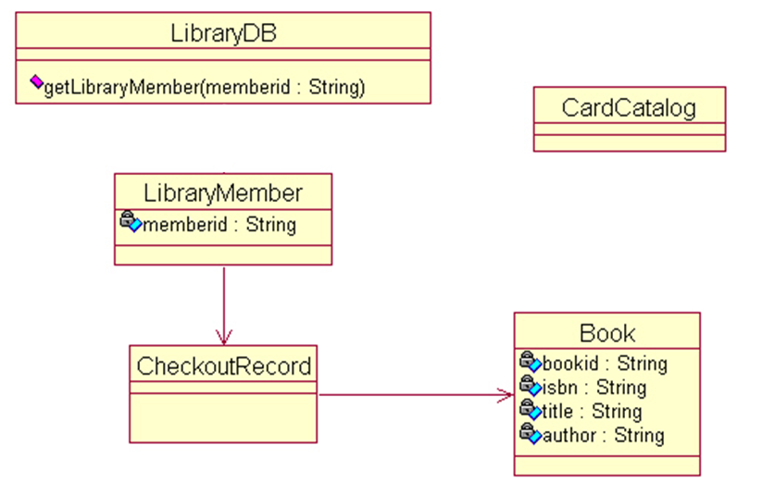
Example: Key Abstractions
Notes:
ID Course Overview

Slide 21
Module Summary
1. Architecture Analysis is an activity performed by the system architect in preparation for use case analysis.
2. Goal is to identify an initial system architecture--preferably one that separates the project into nonchanging and changing subsets, and the changing elements should be grouped such that those grouped together tend to change together.
3. Analysis mechanisms are identified which are known solution patterns to complex problems.
4. Key abstractions are identified which will provide a common set of elements across use case realizations.
Notes:
ID Course Overview

Slide 22
Review of Architectural Analysis
Describe the purpose of Architectural Analysis.
What is a package and what is it used for?
Describe the rationale for defining analysis mechanisms.
How are key abstractions identified during architectural analysis? Why are they identified?
What are the typical layers in a layered architecture? What advantages does this type of architecture offer?
Notes:
ID Course Overview

